Slide 1
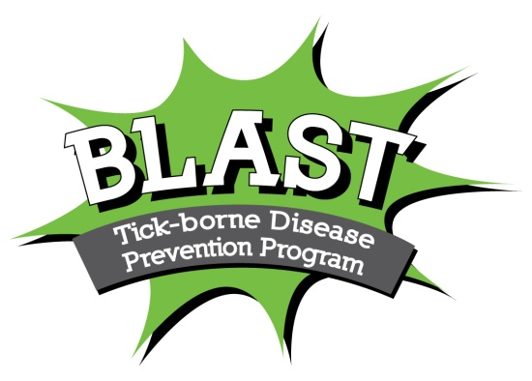
Ridgefield Health Department
Ridgefield, CT 06877
Blastlyme.org
Notes:
The BLAST Tick-borne Disease Prevention Program is a community-based health initiative designed to teach tick-borne disease prevention strategies and encourage early symptom identification. The program was created in 2008 by a team of researchers, educators and community members in partnership with the Ridgefield Health Department. Funding was provided by the Connecticut Department of Public Health.

Slide 2
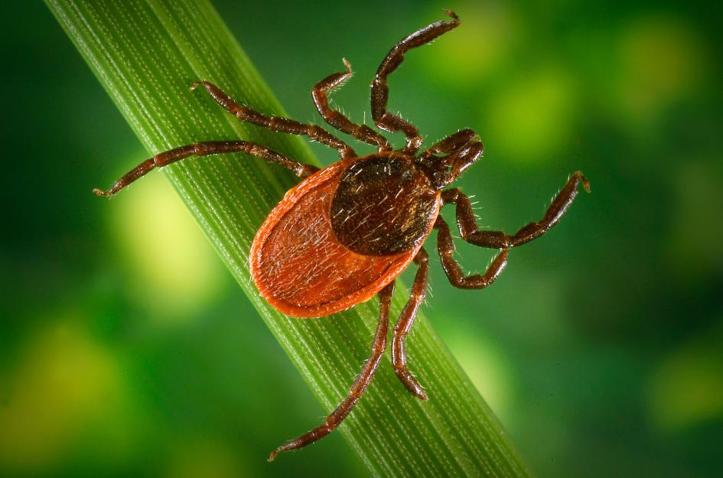
Which tick-borne diseases should we be concerned about?
Several diseases can be acquired from the bite of an infected blacklegged (deer) tick:
Lyme Disease
Babesiosis
Anaplasmosis
Borrelia miyamotoi
Powassan Disease
      P
      PHOTOGRAPH BY JIM GATHANY, CDC/PHIL/CORBIS
Notes:
There are approximately 20 tick species of major public health or veterinary importance in the United States and over a dozen human tick-borne diseases that affect humans. We know that several disease can be acquired from the bite of an infected blacklegged tick , often referred to as a deer tick. Lyme Disease is still most common, but health departments are monitoring the rise of Babesiosis and Anaplasmosis. Borrelia miyamotoi and Powassan disease are less common, but can have serious health consequences. It is possible to acquire multiple infections from one tick attachment. While there are other types of ticks in our area, which may carry other diseases, the blacklegged ticks and Lyme disease continue to be our greatest health threat.

Slide 3
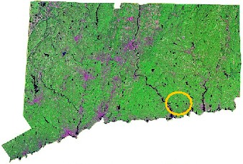


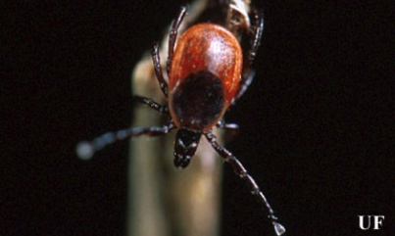
Named after first cases in Lyme, CT (1975)
Photograph by Michael Patnaude, University of Florida.
Notes:
Lyme disease was first identified in 1975 when a cluster of children and adults residing in the Lyme, Connecticut area experienced uncommon arthritic symptoms. A local mother, Polly Murray, is credited with initiating the medical investigation that resulted in the discovery of this new illness. By 1977, the first 51 cases of Lyme arthritis were described, and the Ixodes scapularis or black-legged tick was linked to the transmission of the disease.

Slide 4
Lyme disease in the United States
According to the CDC, Lyme disease is the most commonly reported vector-borne illness in the United States with more than 300,000 new cases annually.
In 2014, it was the 5th most common nationally reportable disease
with 96% of confirmed cases reported from 14 states:
Connecticut Delaware
New York Maine
Pennsylvania Maryland
Rhode Island Vermont
Virginia New Jersey
Wisconsin New Hampshire
Massachusetts Minnesota
Notes:
According to the Centers for Disease Control and Prevention (CDC), Lyme disease is the most commonly reported vector borne illness in the United States with over 300,000 new cases annually. In 2014, Lyme disease was the 5th most common nationally reportable disease with 96% of confirmed cases reported from 14 states. The list includes all six New England states.

Slide 5
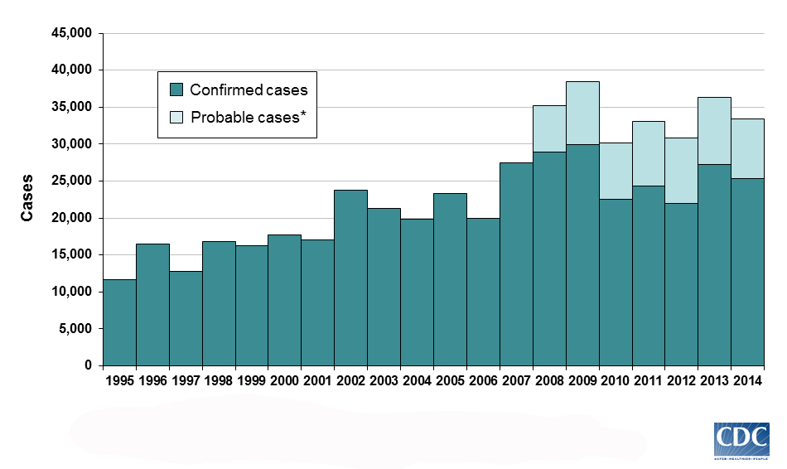
Lyme disease is on the rise.
Notes:
While the criteria for reporting Lyme disease cases has varied over the years, we see a clear upward trend since 1995.

Slide 6
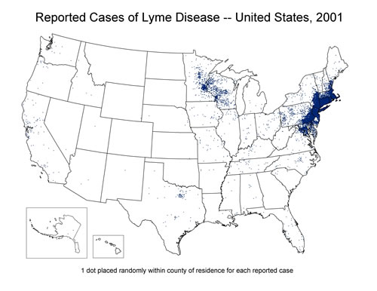

Lyme disease cases 2001
Notes:
These case maps compiled by the CDC clearly show that the number of Lyme disease cases has increased…

Slide 7
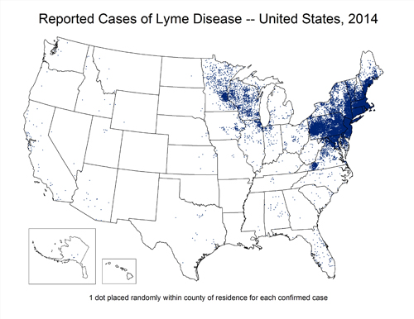
Lyme disease cases 2014
Notes:
and the geographic distribution has expanded.

Slide 8




Celebrities with Lyme disease
Notes:
Today, it’s not uncommon to hear celebrities speaking about their struggles with Lyme disease.

Slide 9
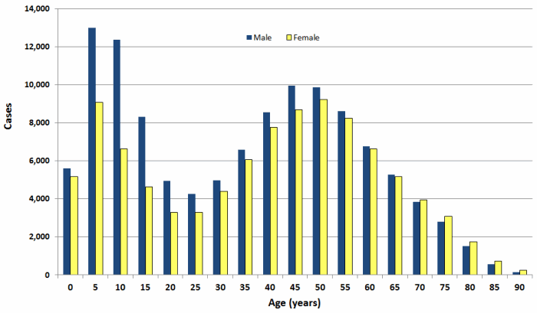
Who gets tick-borne diseases? Everyone.
Confirmed Lyme disease cases by age and sex--United States, 2001-2010
Notes:
So, who is likely to get Lyme disease? Everyone living in or traveling to a Lyme endemic area. While we often think about Lyme disease when preparing for a hike or camping trip, most people are exposed to infected ticks working or playing in their own backyard. Nationally, children, especially young boys ages 5 to 9, are at greatest risk.

Slide 10
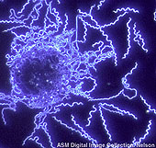
What exactly is Lyme disease?
Lyme disease is a bacterial infection caused by the spirochete
Borrelia burgdorferi.
This organism attacks various organ systems in the body:
  Nervous System
  Activity System
  Circulatory System
Notes:
So what exactly is Lyme disease? Lyme disease is a bacterial infection caused by the spirochete Borrelia burgdorferi. This organism attacks various organ systems in the body, including the:
Nervous System (Bell’s palsy, meningitis, jabbing pain)
Activity System (arthritis, migratory, joint pain, swelling)
Circulatory System (heart block, rhythm abnormalities)

Slide 11

Early Lyme disease symptoms
Symptoms typically appear 2-30 days after the bite of
an infected tick.
Early symptoms:
  Expanding "bull's-eye" rash
  Flu-like Symptoms
  Fever
  Malaise
  Fatigue
  Headache
  Muscle aches
  Joint aches
Notes:
Lyme disease symptoms are often described as “early” and “late”. Early symptoms typically appear two to 30 days after the bite of an infected tick. The Lyme disease bacterium can infect several parts of the body, producing different symptoms at different times. Not all patients with Lyme disease will have all symptoms, and many of the symptoms can occur with other diseases as well. Early symptoms may include an expanding rash, often presenting as a “bulls-eye”, flu-like symptoms, fever, malaise, fatigue, headaches, muscle aches and joint aches. Individuals who recognize these early symptoms and receive timely treatment often recover without any further complications.

Slide 12
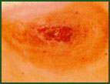
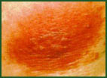

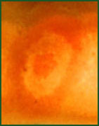
Examples of the "bull's-eye" rash:
L. Zemel
S. Luger
J. Stratton
A. McDonald
*Photos provided by Pfizer
Notes:
The rash associated with Lyme disease is called erythema migrans or EM. This rash begins at the site of a tick bite after a delay of three to 30 days. A distinctive feature of the rash is that it gradually expands over a period of several days, reaching up to 12 inches across. The center of the rash may clear as it enlarges, resulting in a bull's-eye appearance. But, as you can see in these pictures of EM rashes, the shape can vary. It may be warm but isn’t usually painful. Some patients develop additional EM rashes in other areas of the body. It’s important to know that not everyone with Lyme disease gets a rash. But, when it does appear, the rash is a clear indication of Lyme disease infection and should be shown to a medical practitioner immediately. We suggest taking a picture of the rash for your records.

Slide 13
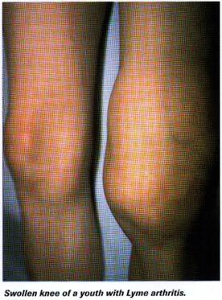
Later signs and symptoms
Severe headaches and neck stiffness
Additional rashes
Arthritis
Facial or Bell's palsy
Intermittent pain
Heart palpitations or an irregular
heart beat (Lyme carditis)
Episodes of dizziness or shortness of breath
Inflammation of the brain and spinal cord
Nerve pain
Shooting pains, numbness, or tingling
Problems with short-term memory
Source: National Library of Medicine
Notes:
The “Late” Signs and Symptoms of Lyme disease, which may occur days to months after a tick bite, often include:
Severe headaches and neck stiffness
Additional EM rashes on other areas of the body
Arthritis with severe joint pain and swelling, particularly the knees and other large joints.
Facial or Bell's palsy (loss of muscle tone or droop on one or both sides of the face)
Intermittent pain in tendons, muscles, joints, and bones
Heart palpitations or an irregular heart beat, known as Lyme cardiditis
Episodes of dizziness or shortness of breath
Inflammation of the brain and spinal cord
Nerve pain
Shooting pains, numbness, or tingling in the hands or feet
And problems with short-term memory

Slide 14
How is Lyme disease diagnosed?
Lyme disease is diagnosed based on symptoms, physical findings (e.g., rash), and the possibility of exposure
to infected ticks; laboratory testing is helpful if used correctly.
Notes:
Unlike many diseases, doctors can’t rely solely on a lab test when making their diagnosis. Lyme disease is diagnosed based on symptoms, physical findings such as the EM rash, and the possibility of exposure to infected ticks. Laboratory testing is helpful when used correctly.

Slide 15
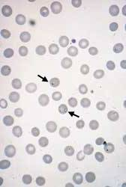
What is babesiosis?
A malaria-like illness caused by a protozoan called Babesia microti. This parasite invades and lives within red blood cells.
http://www.aafp.org
Arrows indicate infected RBCs
Notes:
Diseases occurring in conjunction with Lyme disease are referred to as co-infections. One of the most common is babesiosis, a malaria-like illness caused by a protozoan called Babesia microti. This parasite invades and lives within red blood cells.

Slide 16
Symptoms are mostly nonspecific, and the illness can range from very mild to very severe; although most people will not have symptoms.
Symptoms may include:
Fever
Drenching sweats
Muscle or joint aches or pains
A blood test may find a breakdown of the red blood cells called hemolytic anemia
Notes:
Symptoms are mostly nonspecific, and the illness can range from very mild to very severe; although most people will not have symptoms. Symptoms may include:
Fever
Drenching sweats
Muscle or joint aches or pains
A blood test may find a breakdown of the red blood cells called hemolytic anemia

Slide 17
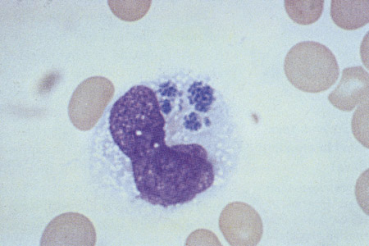
What is anaplasmosis?
Anaplasmosis was formerly known as human granulocytic ehrlichiosis (HGE). These bacteria invade and live in white blood cells called granulocytes.
Note the clumps of Ehrlichia in a white blood cell
http://www.clevelandclinicmeded.com
Notes:
The other illness often found in black-legged ticks is anaplasmosis, formerly known as human granulocytic ehrlichiosis (HGE). These bacteria invade and live within white blood cells called granulocytes.

Slide 18
Much like babesiosis, symptoms are mostly nonspecific, and the illness can range from very mild to very severe. Most patients will experience:
Rapid onset of fever
Shaking
Chills
Muscle or joint pain
Severe headache
Each tick-borne disease has its own test and may have a different treatment protocol.
Notes:
Much like babesiosis, symptoms are mostly nonspecific, and the illness can range from very mild to very severe. Most patients will experience:
Rapid onset of fever
Shaking
Chills
Muscle or joint pain
Severe headache
Each tick-borne disease has its own diagnostic test and often a different treatment protocol.

Slide 19
Are there any vaccines?
There was a vaccine for Lyme disease several years ago, but it is no longer available
If you were previously vaccinated for Lyme disease you are NO LONGER protected
There are no vaccines available for any of the tick-borne diseases, so PREVENTION is key
Notes:
You may have heard about a Lyme disease vaccine. There was a vaccine several years ago, but it was taken off the market. If you were previously vaccinated for Lyme disease you are NO LONGER protected. At the current time, there are no vaccines available for any of the tick-borne diseases, so PREVENTION is key!

Slide 20
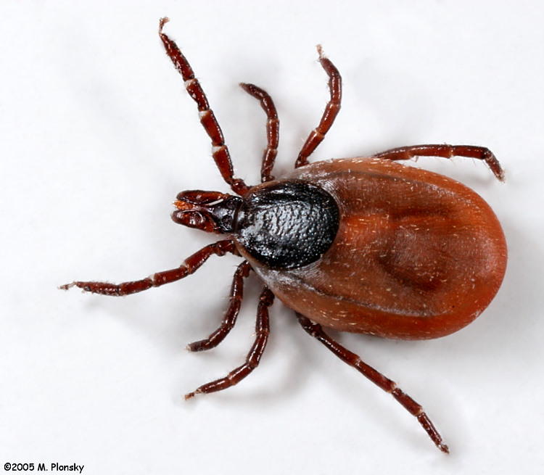
What do blacklegged ticks look like?
Notes:
When we think about prevention, it’s important to understand how tick-borne diseases are transmitted. So, we’ll start with learning what black-legged ticks look like.

Slide 21
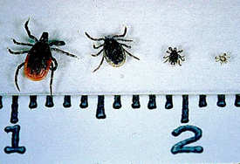
It varies based on their stage…
Adult Female: Reddish body size
comparable to a
sesame seed
Adult Male: Slightly smaller than female, completely dark brown
Nymph: Size comparable to
that of a poppy seed
Larva: Size smaller than
that of a pin head
Larvae may not transmit Lyme, but do transmit other diseases.
From left to right: Adult female, adult male, nymph, larva
Notes:
The blacklegged tick goes through four stages in its life. The nymph, the stage responsible for the greatest number of Lyme disease cases, is less than ¼ the size of the adult female. The adult female is about the size of a sesame seed; the nymph is about the size of a poppy seed. Both the nymph and the adult female can transmit Lyme disease. The nymph is responsible for the greatest number of cases because it is very hard to spot and out in the environment during summer months. Larvae may not transmit Lyme disease, but do transmit other diseases.

Slide 22
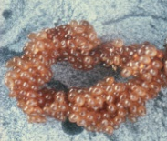
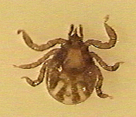
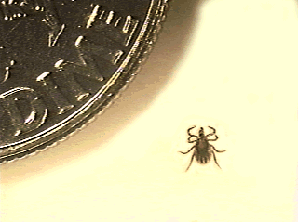
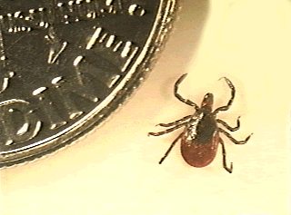
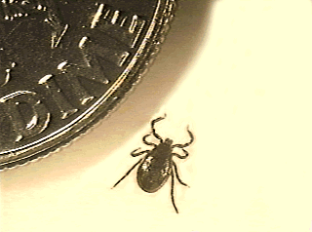
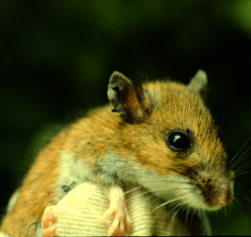
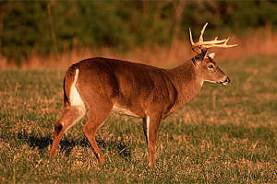
The two year tick life cycle
Year One
Year Two
Spring Summer Autumn Winter Spring Summer Autumn Winter
eggs
larvae
nymphs
adults
Meal 1
Meal 2
Meal 3
Adults mate,
produce eggs & die
Source: Center for Vector-Borne Disease, University of Rhode Island
Notes:
Tick eggs hatch in the Spring. The ticks feed three times in their two-year life cycle. Tick larvae feed on mice, moles or birds (known as hosts) in late Summer. Larvae and nymphs can acquire the bacteria which causes Lyme disease when feeding on these infected hosts. The white footed mouse is the principle reservoir for the infection. Nymphal ticks feed in the early Spring, and adult ticks feed and reproduce in the Fall and Winter. Adult female ticks lay approximately 2000 to 3000 eggs per tick in leaf litter in the Spring.

Slide 23
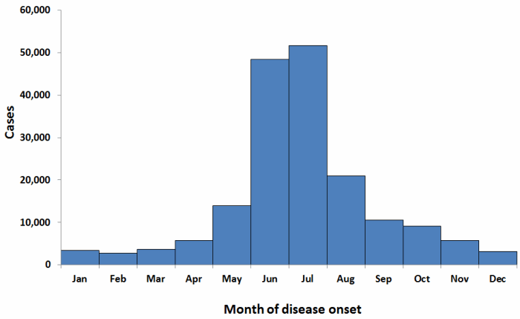
When are you most likely to get Lyme disease?
Confirmed Lyme disease cases by month of disease onset--United States, 2001-2010
Notes:
Lyme disease patients are most likely to have illness onset in June, July, or August and less likely to have illness onset from December through March. But, it is possible to encounter an infected tick whenever there is no snow covering the ground. Cases are reported year ‘round.

Slide 24
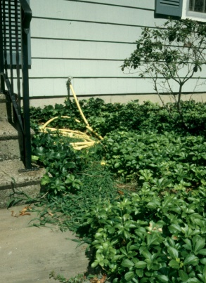


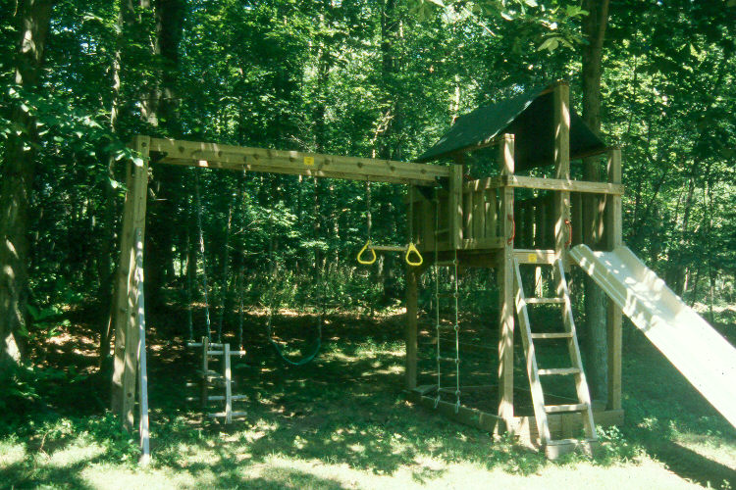
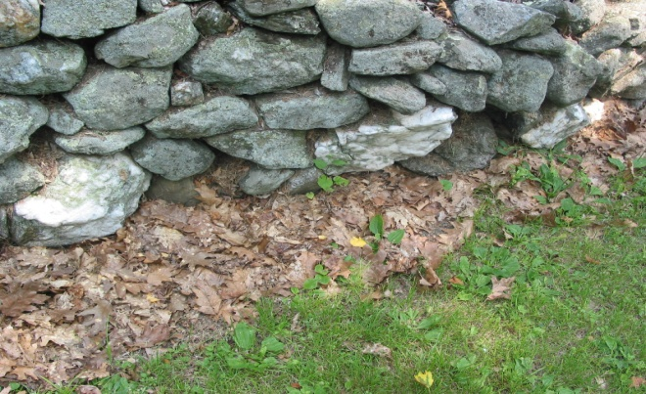

Where do ticks live?
Ticks thrive in shady, moist areas.
Notes:
Ticks like damp shady areas under ground covering plants such as pachysandra, myrtle and ivy. They can be found near stone walls. Ticks often hitch a ride on a small rodent such as the white-footed mouse, so you will find ticks in areas that mice find attractive. Dead tree trunks and branches, tall grasses and the wooded edge of your property are also places that you may encounter ticks. Stay away from leaf litter, too. Ticks spend 95% of their life in the leaf litter on the forest floor during their 2 year life cycle! Tick populations can also be abundant in areas where deer live. Deer supply ticks with transportation, a place to mate and a blood meal. Be wary of ticks in places where you see a lot of deer, or deer droppings.

Slide 25
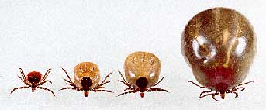
Engorged blacklegged ticks may fool you.
Notes:
The term engorged refers to a tick that has fed and is filled with blood. An engorged deer-tick may fool you as they can expand to the size of a small raisin and are often mistaken for dog ticks which do not carry Lyme disease.

Slide 26
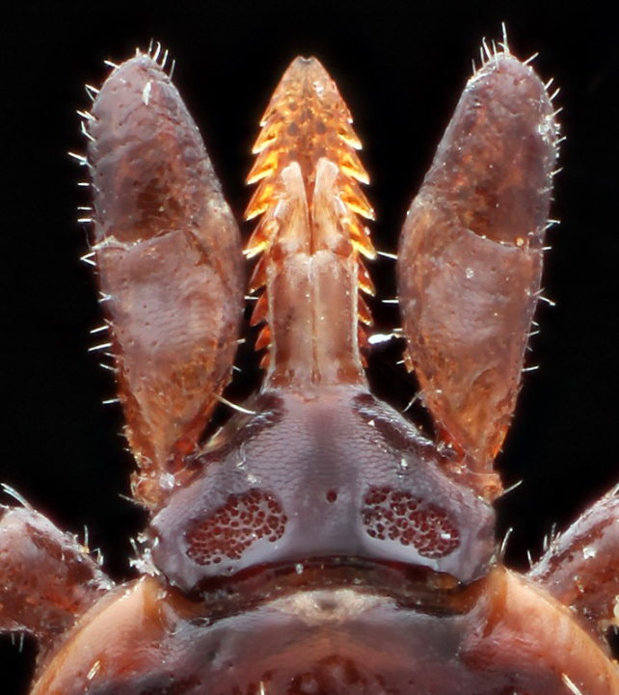
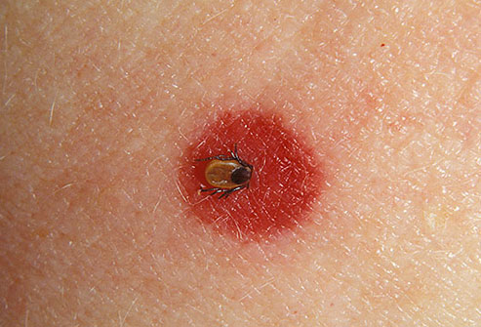
Ticks attach with a unique mouthpart
Notes:
The term tick bite may be misleading as ticks do not bite like a mosquito. Ticks attach and feed gradually. Once a tick has found a place to feed, it grasps and begins to cut into the skin. The hypostome penetrates and the tick secretes a “cement” which holds the mouthparts in place while the tick feeds. This cement is one of the reasons ticks may be hard to remove. Irritation may occur at the site of the bite and should not be mistaken for the EM rash.

Slide 27
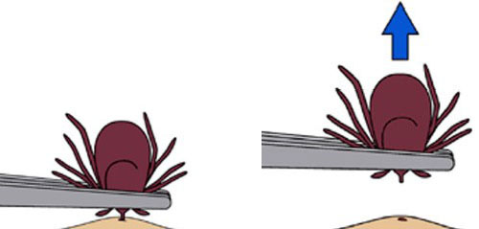
What’s the best way to remove a tick?
Use fine-tipped tweezers.
Grasp the tick by the mouthpart close to the skin.
Pull straight back with a slow, steady force.
Avoid crushing the tick’s body.
Place tick in a plastic vial or zip-lock bag for testing.
Wash area and disinfect the bite site.
Record the date and location of the bite.
Watch for early symptoms.
Notes:
Remove a tick from your skin as soon as you notice it. Use fine-tipped tweezers to firmly grasp the tick very close to your skin. With a steady motion, pull the tick’s body away from your skin with a slow, steady force. Avoid crushing the tick’s body. If the tick’s mouthparts remain in the skin, don’t be alarmed. They can’t transmit the Lyme disease bacteria once separated from the tick’s body. You’ll want to remove them with the same care you would use for a splinter. Always clean your skin with soap and warm water or alcohol after removing a tick.
Place the tick in a plastic vial or zip-lock bag for identification and testing. Always record the date and location of a tick-attachment on your calendar. Consult with your physician and watch for early symptoms.

Slide 28
Tick Removal DON’Ts
Don’t squeeze or rupture the tick.
Don’t pour kerosene or nail polish remover on the tick.
Don’t rub Vaseline or Petroleum Jelly on the tick.
Don’t do ANYTHING that might otherwise traumatize the tick.
Notes:
You may have heard some recommendations for removing ticks that are not effective and may actually increase the risk of pathogen transmission. Don’t squeeze or rupture the tick. Don’t pour kerosene or nail polish remover on the tick. Don’t rub Vaseline or Petroleum Jelly on the tick. You want to avoid doing anything that might otherwise traumatize the tick. Your goal is to remove the tick swiftly and carefully.

Slide 29
Where do you send a tick for testing?
Check with your local Health Department to see if they identify and/or test ticks.
UMass Amherst Laboratory of Medical Zoology and
University of Connecticut Veterinary Medical Diagnostic Laboratory identify and test ticks for a fee.
University of Rhode Island Tick Encounter Resource Center and University of Maine Cooperative Extension Service identify ticks for free.
Some private labs will test ticks for a fee.
Don’t wait for tick-testing results if you suspect that you have contracted a tick-borne disease. See your physician immediately!
Notes:
After a tick is removed, you may want to consider having it tested to see if it’s positive for any of the tick-borne diseases. It’s important to know that even if the tick is infected, it doesn’t mean that the infection has been transmitted. There are many factors involved in this process.
Local Health Departments, universities and private labs offer tick testing services.
Never wait for tick-testing results before seeing your physician if you suspect that you’ve contracted a tick-borne disease.
Check with your local Health Department to see if they identify and/or test ticks.
Umass Amherst Laboratory of Medical Zoology and
University Connecticut Veterinary Medical Diagnostic Laboratory
identify and test ticks for a fee.
University of Rhode Island Tick Encounter Resource Center and University of Maine Cooperative Extension Service identify ticks for free
Some private labs will test ticks for a fee.
Don’t wait for tick-testing results if you suspect that you have contracted a tick-borne disease. See your physician immediately!

Slide 30
How do you avoid getting a tick bite?
Notes:
So how do you avoid getting a tick bite? The BLAST tips include those recommendations science has shown have the greatest potential to reduce your chances of contracting a tick-borne disease. These are easy, affordable ways you can avoid ticks and their bites in your daily life. You don’t have to travel far to find a tick!.

Slide 31
BLAST
Notes:
The “B” in BLAST reminds us to….

Slide 32

Bathe or shower soon after coming indoors.
Bathing or showering
within 2 hours of
outdoor activity
helps remove ticks
that haven’t attached.
Notes:
…bathe or shower soon after coming indoors. Data from a study conducted by the Connecticut Emerging Infections Program at the Yale School of Public Health has shown that people who did not contract Lyme disease were nearly twice as likely to shower or bathe within 2 hours after spending time in their yards. Bathing washes off unattached ticks and provides the perfect opportunity to do a thorough tick check. Ticks may still be on your clothing, so put clothes in a hot dryer for 10 minutes if they’re dry or 50 minutes if they’re wet. Washing clothes alone doesn’t kill ticks.
*Connally, Durenat, Yousey-Hindes, Meek, Nelson & Heimer, 2009

Slide 33
BLAST
Notes:
The “L” in BLAST …

Slide 34
Look for ticks and rashes.
Tick bites are usually painless, therefore most people are unaware when they have a tick attached to them.
Ticks are very small, and
may feed anywhere on the
body, so check thoroughly.
Check under your arms, in your ears, the belly button and behind your knees.
Do a tick check every night.
CDC
Notes:
… reminds everyone to look for ticks and rashes on your body after coming indoors. Finding and removing an attached tick as soon as possible may reduce your risk of getting the disease… so the sooner the better! Check under your arms, in your ears, the belly button, behind your knees and in other places where a tick may go undetected. Ticks are very small, and may feed anywhere on the body so check thoroughly. Tick bites are usually painless. That’s why people are surprised when they find a tick attached to them. Do a tick check every night…and while you’re looking…check for expanding rashes too.

Slide 35
BLAST
Notes:
“A” stands for…

Slide 36
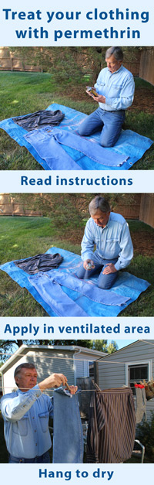
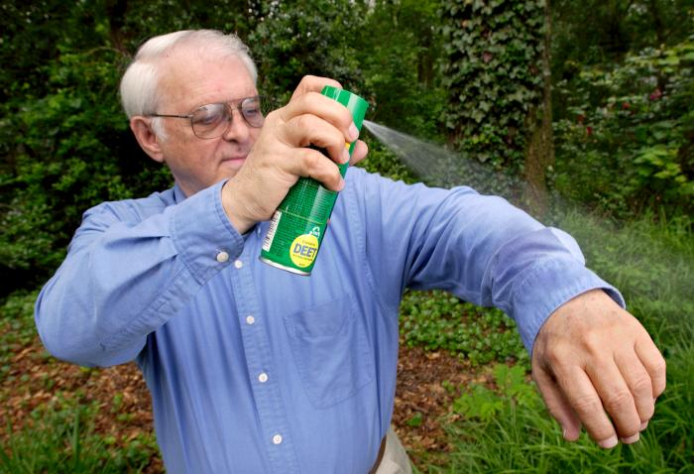
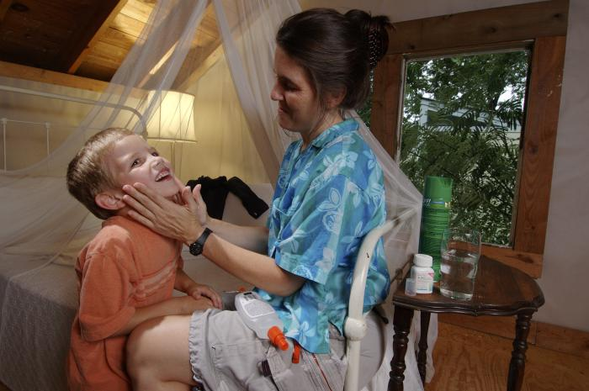
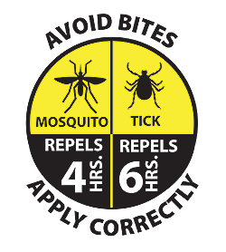
Apply repellents.
SKIN
If you choose to use a tick repellent on your skin, the CDC recommends using a product that contains DEET at a concentration of at least 20%.
CLOTHING
A permethrin based product is recommended for clothing and gear. It provides great protection against ticks!
Photos CDC
Notes:
…applying repellents to skin and/or clothing. The CDC recommends using repellents that contain 20% to 30% DEET (N, N-diethyl-m-toluamide) on exposed skin and clothing for protection that lasts up to several hours. Always follow product instructions. Parents should apply this product to their children, avoiding hands, eyes, and mouth.
Another option is to use products that contain permethrin on clothing and gear. Treat shirts, pants, socks and shoes when you are not wearing them. Spray outdoors in a well ventilated area and allow them to dry before putting these items on. Permethrin remains protective through several washings. Pre-treated clothing is available and may provide longer-lasting protection.

Slide 37


Testing natural products to repel or kill ticks
2-undecanone
Garlic oil
Nookatone
Mixed Essential Oils rosemary, thyme, lemongrass, geranio
Fungus
Notes:
Scientists are studying the effectiveness of all-natural chemical compounds made from plants that can repel or kill ticks. Some possibilities that have shown promise include:
an essential oil from the leaves and stems of the wild tomato plant
an essential oil from garlic plants
essential oils from Alaska yellow cedar trees
some herbs and citrus fruits
and a fungus that grows naturally in soils throughout the world.

Slide 38
BLAST
Notes:
“S” explains the recommendation to spray key areas of the yard that harbor ticks.

Slide 39
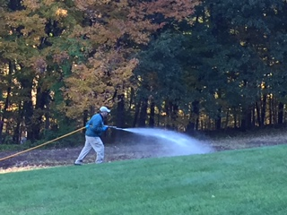
Spray the edges of your yard.
A single perimeter spray for tick control once in the Spring can reduce the number of ticks in your yard by up to 80- 90%.
If you decide to spray your yard, it is best to hire a licensed professional who is trained to do this job efficiently and safely.
Photo: JReid
Tick Management Handbook, CT Agricultural Experiment Station
Notes:
Research has shown spraying for tick control can be very effective. According to the Connecticut Agricultural Experiment Station, a single perimeter spray in the Spring can reduce the number of ticks in your yard by up to 80 – 90%. This should be a high power spray targeting tick habitat areas. Concentrate on:
-The yard perimeter where the lawn meets the wooded edge
-Stonewalls
-dense groundcover plantings
-Several yards into bordering woodlands
You do not need to treat short, well manicured lawn areas that are in full sun. Ticks are found in shady, moist, untended areas. Watch out for leaf litter, wood piles and invasive plants such as Barberry bushes that provide a safe habitat for rodents and the ticks they carry.

Slide 40
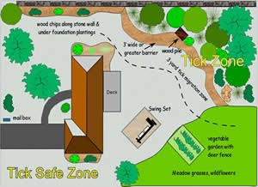
Create a “Tick-Safe” zone.
Clear tall grasses and brush.
Add a 3-ft wide barrier of wood chips or gravel between lawns and wooded areas.
Mow the lawn frequently.
Keep leaves raked.
Stack wood neatly in a dry area.
Keep playground equipment and patio furniture away from yard edges and in a sunny location.
Choose deer resistant plants.
Avoid feeding wild animals & birds.
Westport/Weston Health District
Notes:
Recognizing that most people become infected with tick-borne diseases close to home, researchers have focused on understanding all of the effective ways to reduce the number of ticks in your own backyard.
These include:
Clearing tall grasses and brush
Adding a 3-ft wide barrier of wood chips or gravel between lawns and wooded areas
Mowing the lawn frequently and raking leaves.
Stacking wood neatly in a dry area
Keeping playground equipment and patio furniture away from yard edges and in a sunny location.
Choosing deer resistant plants
Removing plants that harbor ticks
Not feeding wild animals & birds

Slide 41
BLAST
Notes:
The “T” in BLAST reminds us that animals suffer from tick-borne diseases too and often carry ticks in to the home on their fur.

Slide 42






Treat your pets.
Check your pets for ticks after coming indoors.
Ask your vet about vaccines and products that will help your pet repel ticks.
Don’t sleep with your pet because ticks on your pet may crawl on to you.
Notes:
Pets, especially dogs, can be seriously impacted by tick-borne diseases. Unfortunately, vaccines are not available for all the illnesses dogs can get from ticks, and they don’t keep your pet from bringing ticks into the house. For these reasons, it’s important to use a tick prevention product for your dog or cat and to check your pets daily for ticks, especially after coming indoors.
Ask your veterinarian about the ticks found in your area, vaccines, topical products, collars, and other prevention methods available. Don’t allow pets to sleep on your bed as ticks may crawl off the dog or cat and on to a family member. Cats are extremely sensitive to a variety of chemicals so don’t apply any insect acaricides or repellents to your cats without first consulting your veterinarian!
Tick bites on pets may be hard to detect. Signs of tick-borne disease may not appear for 7-21 days or longer after a tick bite, so watch your dog closely for changes in behavior or appetite if you suspect that your pet has been bitten by a tick. Symptoms may include fever, lack of appetite, lameness and joint swelling.

Slide 43
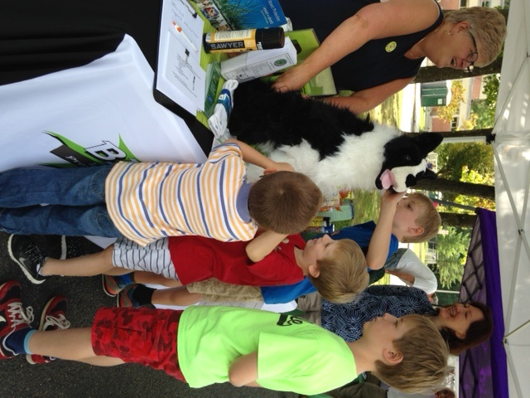





Join our team and help tackle tick-borne diseases!
Notes:
We hope this information about ticks, tick-borne diseases and prevention will help keep you safe from tick-borne diseases. Please take a few minutes around the dinner table, at the office or at school to share what you’ve learned. Encourage the people you care about to avoid tick habitat, dress protectively, bathe after outdoor activities, check daily for ticks and rashes, use repellents, safeguard the yard and protect their pets. With your help, we will tackle tick-borne diseases!

Slide 44
Information provided by:
Centers for Disease Control and Prevention (CDC)
CT Agricultural Experiment Station
Tick Management Handbook
CT Department of Public Health
Westport/Weston Health District
Yale School of Public Health
Peridomestic Lyme Disease Prevention:
Results of a Population-Based Case–Control Study
Neeta P. Connally, PhD, Amanda J. Durante, PhD, Kimberly M. Yousey-Hindes, MPH, James I. Meek, MPH, Randall S. Nelson, DVM, Robert Heimer, PhD
Notes:
Information in the BLAST program is based on recommendations and research from the following sources:
Centers for Disease Control and Prevention (CDC)
Connecticut Agricultural Experiment Station Tick Management Handbook
Connecticut Department of Public Health
Westport/Weston Health District
Emerging Infections Program/Yale School of Public Health

